Slide 1
CHANTELLE

Slide 2

Chantelle is an online fashion company founded by The Phoenix.

Slide 3
MODULES AND LIBRARIES

Slide 4
Date time module: It supplies classes for manipulating dates and times. While the date and time arithmetic is supported , the focus of the implementation is on efficient attribute extraction for output formatting and manipulation.
Math Module: It has various useful functions which help us to perform mathematical calculations easily.
CSV module: This module implements classes to read and write tabular data in CSV format.

Slide 5
FLOW OF CONTROL

Slide 6
Log in / sign up
Are u registered?
-no-> Sign up now for free!!-> enter your details
-yes-> enter email id and password -> verified-> show catalogue
->not verified-> please sign up-> enter your details

Slide 7
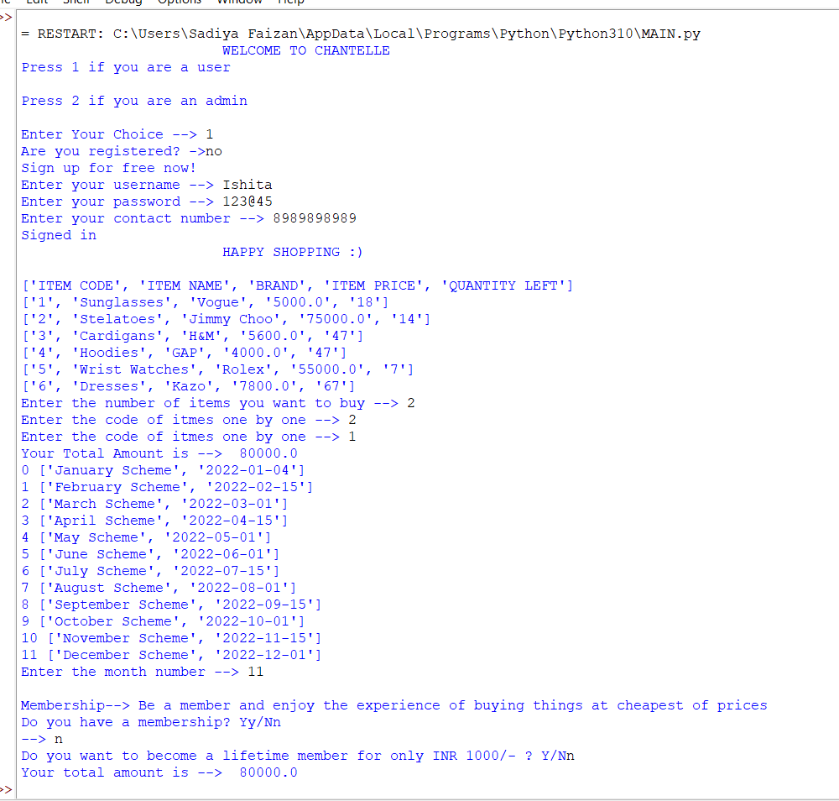

Slide 8
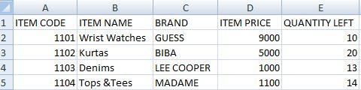
Catalogue
a csv file containing the records

Slide 9
Add to cart
->choose the no. of items
-> if no. of items ==0-> break
->if no. of items != 0->(loop runs n times)
->enter the item code one by one
Schemes
->offers going on right now (using the date time module)

Slide 10
Membership
->do you have a membership?
-> no--> want to become a member?
--> no --> billing
->yes-->display membership offers(choose your offer)
->yes--> display points-->do you want to use them-->yes/no-->billing

Slide 11
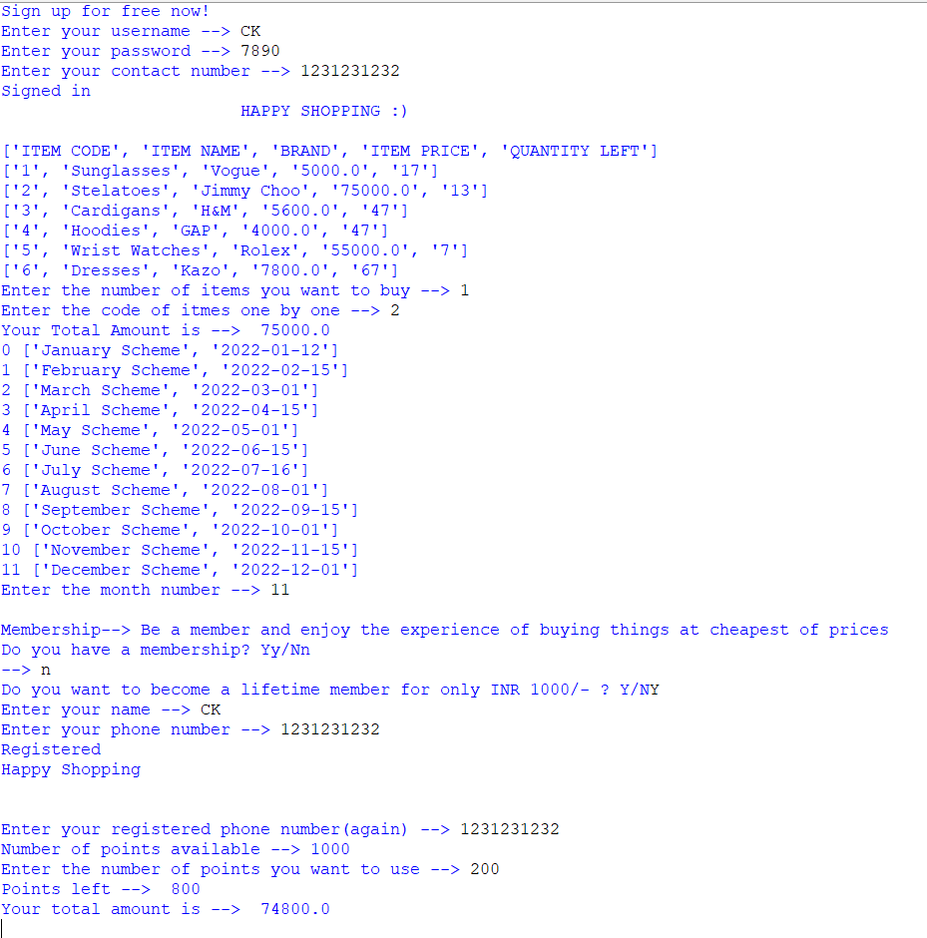

Slide 12
Billing
->extracting required information using csv
-> using math module
-> Ask for location
->shipping cost
->total sum
->credit card details
Schemes
->offers going on right now (using the date time module
Help
->contact no.and email id

Slide 13
FUTURE SCOPE
The program would turn into a proper website with more functions and variety in terms of goods and services we can provide.

Slide 14
THANKS!
Any questions?
You can find us at Phoenix@gmail.com

